Slide 1
Azure Storage
Azure CLI, ARM Templates
PRESENTED BY:
Manikanta Sami
Lead Software Engineer
Notes:
Self Introduction, MSDN Info, Case studies by experience
-------------------
CLI Intro – PowerShell vs CLI
-------------------
ARM - Azure Resource Manager is the deployment and management service for Azure. It provides a management layer that enables you to create, update, and delete resources in your Azure subscription. You use management features, like access control, locks, and tags, to secure and organize your resources after deployment.

Slide 2
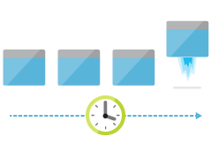


WHY ARM?
Deploy
Organize
Control
Notes:
Declarative Syntax
Repeatable Results
Built-in Validation
Modular
Tracked Deployment
CI/CD Integration
Exportable Code

Slide 3
Consistent Management Layer
Azure Resource Manager API
Notes:
All capabilities that are available in the portal are also available through PowerShell, Azure CLI, REST APIs, and client SDKs. Functionality initially released through APIs will be represented in the portal within 180 days of initial release.

Slide 4
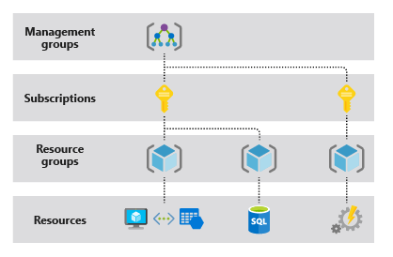
TERMINOLOGIES
Resource
Resource Group
Resource Provider
Resource Manager Template
Declarative Syntax
Notes:
Resource Providers - https://docs.microsoft.com/en-us/azure/azure-resource-manager/resource-manager-supported-services
Show sample JSON file

Slide 5
RESOURCE GROUP
container for multiple resources
resources exist in one* resource group
resource groups can span regions
resource groups can span services
RESOU
R
CE G
R
OUP
*and only one

Slide 6
RESOURCE MANAGER TEMPLATE
Template Functions
resourceGroup() properties
Subscription() properties
Parameters
Variables
User-defined Functions
Resources
Outputs
*and only one
Notes:
Demo in VS Code
----------------------
Template Functions – Built-in functions - https://docs.microsoft.com/en-us/azure/azure-resource-manager/resource-group-template-functions
Parameters - You can't use the reference function or any of the list functions in the parameters section. These functions get the runtime state of a resource and can't be executed before deployment when parameters are resolved.
Escape Characters – [, \”
Custom Functions Limitations
----------------
The function can't access variables.
The function can only use parameters that are defined in the function. When you use the parameters function within a user-defined function, you're restricted to the parameters for that function.
The function can't call other user-defined functions.
The function can't use the reference function or any of the list functions.
Parameters for the function can't have default values.
Resources - https://docs.microsoft.com/en-us/azure/azure-resource-manager/resource-group-authoring-templates#resources

Slide 7
base64encode(‘stringtoencode’)
concat(‘string’,’to’,’encode’)
copyIndex(offset)
listKeys(storageAccountResourceId, apiVersion)
padLeft(stringToPad,targetLength,paddingCharacter)
parameters(‘parameterName’)
providers(namespace, resourceType)
reference(resourceId,apiVersion)
resourceGroup()
resourceId(‘namespace/resourceType', ‘resourceName’)
subscription()
variables(‘variables’)
@ A GLANCE - TEMPLATE LANGUAGE EXPRESSIONS*
base64encode(‘stringtoencode’)
concat(‘string’,’to’,’encode’)
copyIndex(offset)
listKeys(storageAccountResourceId, apiVersion)
padLeft(stringToPad,targetLength,paddingCharacter)
parameters(‘parameterName’)
providers(namespace, resourceType)
reference(resourceId,apiVersion)
resourceGroup()
resourceId(‘namespace/resourceType', ‘resourceName’)
subscription()
variables(‘variables’)
*Looking for examples? See these in action @ https://github.com/rjmax/ArmExamples

Slide 8
DEPLOYMENT PROCESS
"resources": [
{
"apiVersion": "2016-01-01",
"type": "Microsoft.Storage/storageAccounts",
"name": "mystorageaccount",
"location": "westus",
"sku": {
"name": "Standard_LRS"
},
"kind": "Storage",
"properties": {
}
}
]
PUT
https://management.azure.com/subscriptions/{subscriptionId}/resourceGroups/{resourceGroupName}/providers/Microsoft.Storage/storageAccounts/mystorageaccount?api-version=2016-01-01
REQUEST BODY
{
"location": "westus",
"properties": {
}
"sku": {
"name": "Standard_LRS"
},
"kind": "Storage"
}

Slide 9
DEPLOYING WITH AZURE RESOURCE MANAGER
Template-driven
Declarative
Idempotent
Multi-Service
Multi-Region
Extensible

Slide 10
imperative or declarative
New-AzureVM –VM $myVM
New-AzureStorageAccount –StorageAccountName $acct
Set-AzureVNetConfig –ConfigurationPath -Path
{
"$schema": "https://../deploymentTemplate.json#",
"contentVersion": "1.0.0.0",
"parameters": {},
"variables": {},
"resources": [],
"outputs": {}
}

Slide 11
Deployment
tracks template execution
created within a resource group
allows nested deployments
RESOU
R
CE G
R
OUP

Slide 12
Demo: PowerShell + Hello World
Notes:
PowerShell – https://docs.microsoft.com/en-us/powershell/azure/install-az-ps?view=azps-2.7.0
https://docs.microsoft.com/en-us/powershell/azure/new-azureps-module-az?view=azps-2.7.0
CLI - https://docs.microsoft.com/en-gb/cli/azure/install-azure-cli?view=azure-cli-latest

Slide 13
Demo: Azure CLI + Storage Account
Notes:
Template Gallery - https://azure.microsoft.com/en-gb/resources/templates/
Visual Studio – WebApp
VS Code – WebApp/Storage Account
Cloud Shell - https://shell.azure.com/
Azure PowerShell

Slide 14
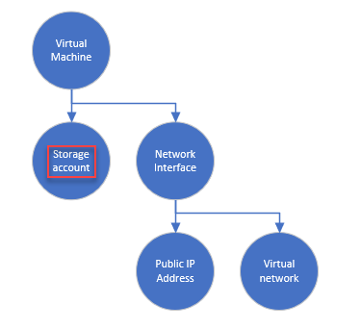
Resource Extensions
VM+DSC/Chef/Puppet/CustomScript/etc.
AppService + WebDeploy
SQL DB + BACPAC
Copies
Nested Templates
NewOrExisting Patterns
ADVANCED TEMPLATE SCENARIOS
Resource Extensions
VM+DSC/Chef/Puppet/CustomScript/etc.
AppService + WebDeploy
SQL DB + BACPAC
Copies
Nested Templates
NewOrExisting Patterns
Notes:
https://docs.microsoft.com/en-us/azure/azure-resource-manager/resource-group-linked-templates
https://docs.microsoft.com/en-us/azure/azure-resource-manager/resource-manager-tutorial-create-linked-templates
https://github.com/Azure/azure-quickstart-templates/blob/master/elasticsearch/azuredeploy.json

Slide 15
Resource groups
Linked resources
Tags
ORGANIZING WITH AZURE RESOURCE MANAGER
Resource groups
Linked resources
Tags

Slide 16
APP-CENTRIC RESOURCE GROUPS AND TEMPLATES
Resource Group
My
3 Tier
Template
App
Service
Virtual
SQL DB
Machine
reference()

Slide 17
APP-CENTRIC RESOURCE GROUPS AND TIER-CENTRIC TEMPLATES
Resource Group
My
DB Tier
Template
My
Web Tier
Template
My
VM Tier
Template
App
Service
Virtual
SQL DB
Machine
reference()

Slide 18
APP-CENTRIC RESOURCE GROUPS AND NESTED TEMPLATES
Resource Group
Parent Template
My Nested
Web Tier
Template
My Nested
DB Tier
Template
My Nested
VM Tier
Template
App
Service
Virtual
SQL DB
Machine
reference()

Slide 19
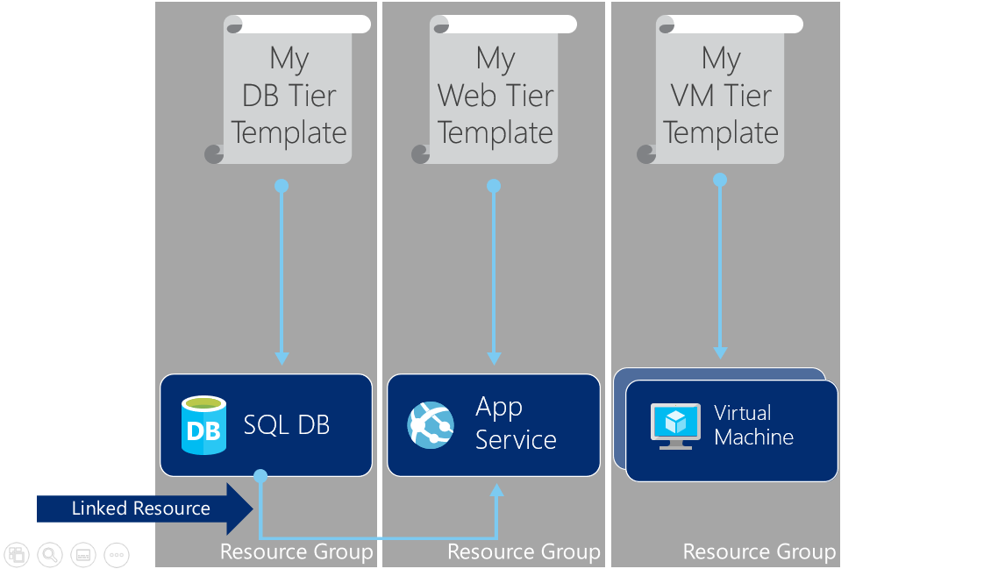
TIER-CENTRIC RESOURCE GROUPS AND TEMPLATES

Slide 20
RESOURCE TAGS
15
x
Name-value pairs assigned to resources or resource groups
Subscription-wide taxonomy
Each resource can have up to 15 tags

Slide 21
TAGGING TIPS
x15
Tag by environment, e.g. dev/test/prod
Tag by role, e.g. web/cache/db
Tag by department, e.g. finance/retail/legal
Tag by responsible party, e.g. Bob

Slide 22
Demo: Azure CLI and tags

Slide 23
CONTROL WITH AZURE RESOURCE MANAGER
Role based access control
Audit logs
Resource locks

Slide 24
ROLE BASED ACCESS CONTROL
Allows secure access with granular permissions
Assignable to users, groups, or service principals
Built-in roles make it easy to get started

Slide 25
TWO KEY CONCEPTS
Role Definitions
describes the set of permissions (e.g. read actions)
can be used in multiple assignments
Role Assignments
associate role definitions with an identity (e.g. user/group) at a scope (e.g. resource group)
always inherited – subscription assignments apply to all resources

Slide 26
ROLE BASED ACCESS CONTROL

Slide 27
GRANULAR SCOPES
/subscriptions/{id}/resourceGroups/{name}/providers/…/sites/{site}
subscription level – grants permissions to all resources in the sub
resource group level – grants permissions to all resources in the group
resource level – grants permissions to the specific resource

Slide 28
Demo: Role Based Access Control

Slide 29
AUDIT LOGS
journals all write/delete/actions
central location
common format

Slide 30
Demo: Audit Logs

Slide 31
RESOURCE LOCKS
Accidents happen. Resource locks help prevent them :)
Resource locks allow administrators to create policies which prevent write actions or prevent accidental deletion.

Slide 32
KEY CONCEPTS
Resource lock
Policy which enforces a "lock level" at a scope
Lock level
Type of enforcement; current values include CanNotDelete and ReadOnly
Scope:
The realm to which the lock level is applied. Expressed as a URI; can be set at the resource group, or resource scope.

Slide 33
Demo: Resource Locks

Slide 34
Many examples available @ https://github.com/Azure/azure-quickstart-templates
More examples available @ https://github.com/rjmax/ArmExamples
Documentation available @ http://azure.microsoft.com/en-us/documentation/articles/resource-group-overview/
DEPLOY A TEMPLATE TODAY!
Many examples available @ https://github.com/Azure/azure-quickstart-templates
More examples available @ https://github.com/rjmax/ArmExamples
Documentation available @ http://azure.microsoft.com/en-us/documentation/articles/resource-group-overview/

Slide 35
NEXT STEPS
Getting Started
Azure Resource Manager Overview
Using Windows PowerShell with Resource Manager
Using the Azure Cross-Platform Command-Line Interface with the Resource Manager
Using the Azure Portal to manage your Azure resources
Creating and Deploying Applications
Authoring Azure Resource Manager Templates
Deploy an application with Azure Resource Manager template
Troubleshooting Resource Group Deployments in Azure
Azure Resource Manager Template Functions
Advanced Template Operations
Organizing Resources
Using tags to organize your Azure resources
Managing and Auditing Access
Managing and Auditing Access to Resources
Authenticating a Service Principal with Azure Resource Manager
Create a new Azure Service Principal using the Azure classic portal

